Slide 1
Active Learning
Lectured by Shangsong Liang
Notes:
Original slides from Maria-Florina Balcan https://www.cs.cmu.edu/~mgormley/courses/10601b-f16/schedule.html
Haidong Shi, Nanyi Zeng, https://cis.temple.edu/~latecki/Courses/RobotFall08/Talks/activelearning.ppt

Slide 2


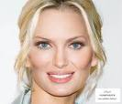
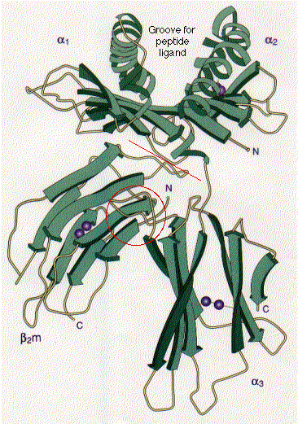
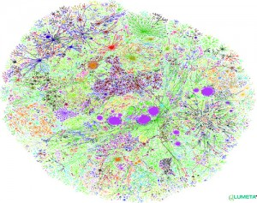
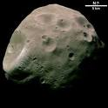
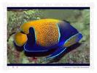







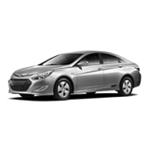

Classic Fully Supervised Learning Paradigm Insufficient Nowadays
Modern applications: massive amounts of raw data.
Only a tiny fraction can be annotated by human experts.
Protein sequences
Billions of webpages
Images

Slide 3

Modern ML: New Learning Approaches
Modern applications: massive amounts of raw data.
Active learning: techniques that best utilize data, minimizing need for expert/human intervention.
Learning Algorithm
Expert

Slide 4
Active Learning
Additional resources:
Two faces of active learning. Sanjoy Dasgupta. 2011.
Active Learning. Bur Settles. 2012.
Active Learning. Balcan-Urner. Encyclopedia of Algorithms. 2015

Slide 5
Batch Active Learning
Data Source
Underlying data distr. D.
Unlabeled examples
Expert
Learning Algorithm
Request for the Label of an Example
A Label for that Example
Request for the Label of an Example
A Label for that Example
. . .
Algorithm outputs a classifier w.r.t D
Learner can choose specific examples to be labeled.
Goal: use fewer labeled examples
[pick informative examples to be labeled].

Slide 6
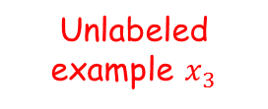


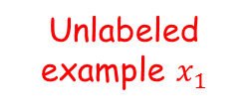

Selective Sampling Active Learning
Data Source
Underlying data distr. D.
Unlabeled example $x_{2}$
Expert
Unlabeled example $x_{3}$
Unlabeled example $x_{1}$
Learning Algorithm
A label $y_{1}$for example $x_{1}$
A label $y_{3}$for example $x_{3}$
Request for label or let it go?
Request label
Request label
Let it go
Algorithm outputs a classifier w.r.t D
Selective sampling AL (Online AL): stream of unlabeled examples, when each arrives make a decision to ask for label or not.
Goal: use fewer labeled examples
[pick informative examples to be labeled].

Slide 7
What Makes a Good Active Learning Algorithm?
Guaranteed to output a relatively good classifier for most learning problems.
Doesn’t make too many label requests.
Hopefully a lot less than passive(被动的，消极的) learning and SSL.
Need to choose the label requests carefully, to get informative labels.

Slide 8
Can adaptive querying really do better than passive/random sampling?
YES! (sometimes)
We often need far fewer labels for active learning than for passive.
This is predicted by theory and has been observed in practice.

Slide 9

Can adaptive querying help? [CAL92, Dasgupta04]
Threshold fns on the real line:
h_{w}(x) = 1(x ¸ w), C = {h_{w}: w 2 R}
-
+
Active Algorithm
w
Get N unlabeled examples
How can we recover the correct labels with $≪N$ queries?
Do binary search!
Just need O(log N) labels!
+
-
-
Output a classifier consistent with the N inferred labels.
$N=O(1/ϵ)$ we are guaranteed to get a classifier of error $≤ϵ$.
Passive supervised: $Ω(1/ϵ)$ labels to find an ε-accurate threshold.
Active: only $O(\log{1/ϵ})$ labels.
Exponential improvement.

Slide 10
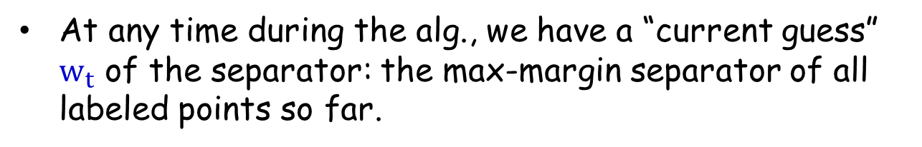
Common Technique in Practice
Uncertainty sampling in SVMs common and quite useful in practice.
E.g., [Tong & Koller, ICML 2000; Jain, Vijayanarasimhan & Grauman, NIPS 2010; Schohon Cohn, ICML 2000]
Active SVM Algorithm
At any time during the alg., we have a “current guess” $w_{t}$ of the separator: the max-margin separator of all labeled points so far.
Request the label of the example closest to the current separator.

Slide 11
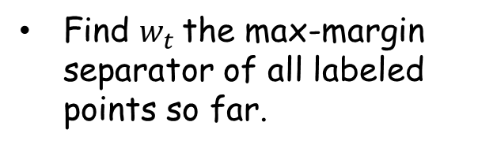

Common Technique in Practice
Active SVM seems to be quite useful in practice.
[Tong & Koller, ICML 2000; Jain, Vijayanarasimhan & Grauman, NIPS 2010]
Algorithm (batch version)
Input $S_{u}$={$x_{1}$, …,$x_{m_{u}}$} drawn i.i.d from the underlying source D
Start: query for the labels of a few random $x_{i}$s.
For $t=1$, ….,
Find $w_{t}$the max-margin separator of all labeled points so far.
Request the label of the example closest to the current separator: minimizing $\left|x_{i}⋅w_{t}\right|$.
(highest uncertainty)

Slide 12
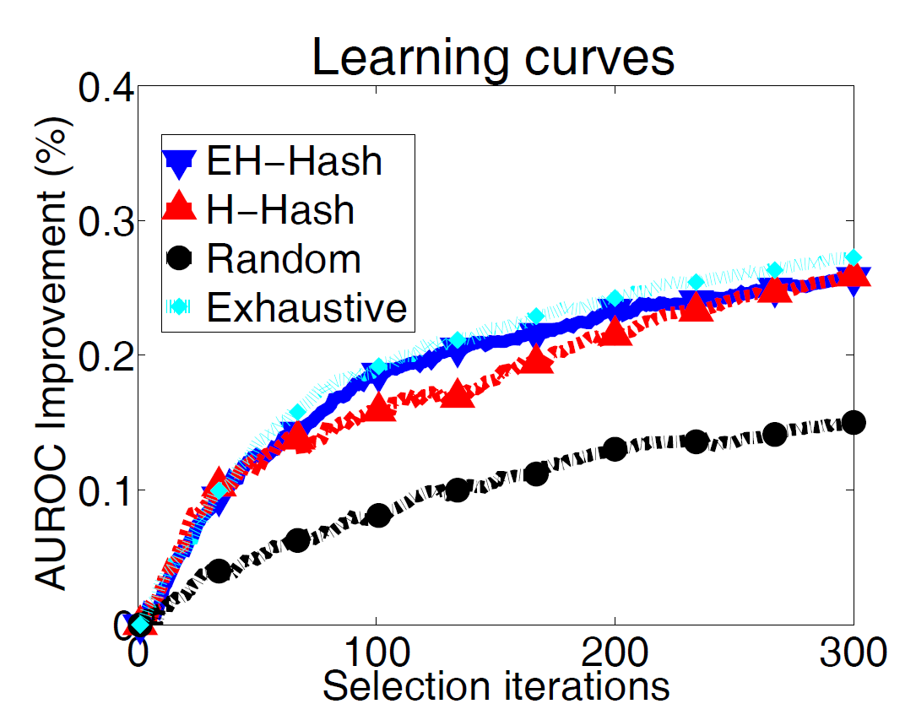
Common Technique in Practice
Active SVM seems to be quite useful in practice.
E.g., Jain, Vijayanarasimhan & Grauman, NIPS 2010
Newsgroups dataset (20.000 documents from 20 categories)

Slide 13
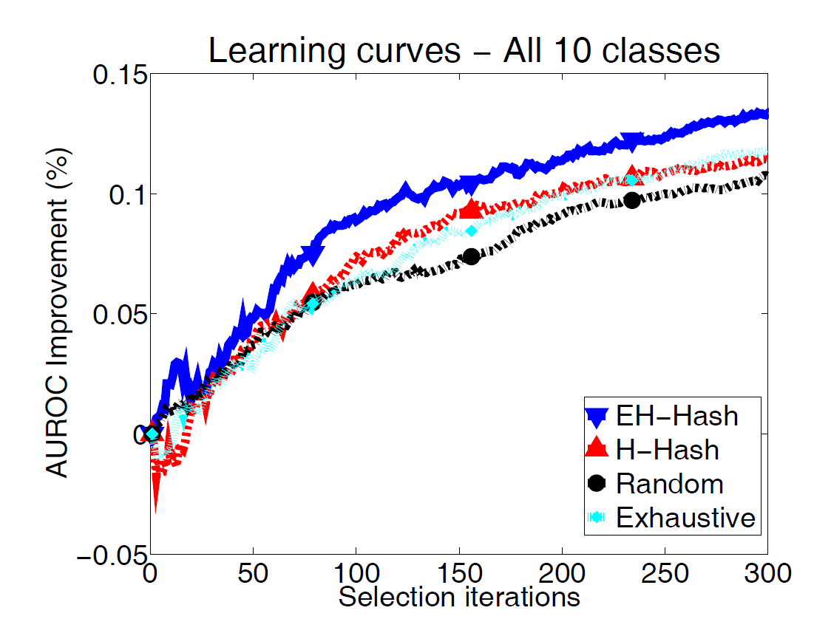
Common Technique in Practice
Active SVM seems to be quite useful in practice.
E.g., Jain, Vijayanarasimhan & Grauman, NIPS 2010
CIFAR-10 image dataset (60.000 images from 10 categories)

Slide 14
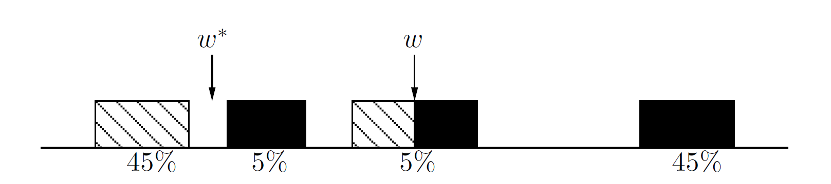
Active SVM/Uncertainty Sampling
Works sometimes….
However, we need to be very very very careful!!!
Myopic(缺乏远见的), greedy technique can suffer from sampling bias.
A bias created because of the querying strategy; as time goes on the sample is less and less representative of the true data source.
[Dasgupta10]

Slide 15
Active SVM/Uncertainty Sampling
Works sometimes….
However, we need to be very very careful!!!

Slide 16
Active SVM/Uncertainty Sampling
Works sometimes….
However, we need to be very very careful!!!
Myopic, greedy technique can suffer from sampling bias.
Bias created because of the querying strategy; as time goes on the sample is less and less representative of the true source.
Observed in practice too!!!!
Main tension: want to choose informative points, but also want to guarantee that the classifier we output does well on true random examples from the underlying distribution.

Slide 17
Safe Active Learning Schemes
Disagreement Based Active Learning
Hypothesis Space Search
[CAL92]
[BBL06]
[Hanneke’07, DHM’07, Wang’09 , Fridman’09, Kolt10, BHW’08, BHLZ’10, H’10, Ailon’12, …]

Slide 18


Version Spaces
X – feature/instance space; distr. D over X; $c^{∗}$ target fnc
Fix hypothesis space H.
Definition (Mitchell’82)
Assume realizable case: $c^{∗}∈H$.
Given a set of labeled examples ($x_{1},y_{1}$), …,($x_{m_{l}},y_{m_{l}}$),
$$y_{i}=c^{∗}(x_{i})$$
Version space of H: part of H consistent with labels so far.
I.e., $h∈ VS(H)$ iff ${h\left(x_{i}\right)=c}^{∗}\left(x_{i}\right)$ $∀i∈\{1, …,m_{l}\}$.

Slide 19
Version Spaces
X – feature/instance space; distr. D over X; $c^{∗}$ target fnc
Fix hypothesis space H.
Definition (Mitchell’82)
Assume realizable case: $c^{∗}∈H$.
Given a set of labeled examples ($x_{1},y_{1}$), …,($x_{m_{l}},y_{m_{l}}$),
$$y_{i}=c^{∗}(x_{i})$$
Version space of H: part of H consistent with labels so far.
current version space
E.g.,: data lies on circle in R², H = homogeneous linear seps.
+
+
region of disagreement in data space

Slide 20
Version Spaces. Region of Disagreement
Definition (CAL’92)
Version space: part of H consistent with labels so far.
Region of disagreement = part of data space about which there is still some uncertainty (i.e. disagreement within version space)
$x∈X, x∈DIS(VS\left(H\right))$ iff $∃{h_{1}, h}_{2}∈VS(H),{ h}_{1}\left(x\right)≠h_{2}(x)$
current version space
E.g.,: data lies on circle in R², H = homogeneous linear seps.
+
+
region of disagreement in data space

Slide 21
Disagreement Based Active Learning [CAL92]
current version space
region of uncertainy
Algorithm:
Pick a few points at random from the current region of uncertainty and query their labels.
Stop when region of uncertainty is small.
Note: it is active since we do not waste labels by querying in regions of space we are certain about the labels.

Slide 22
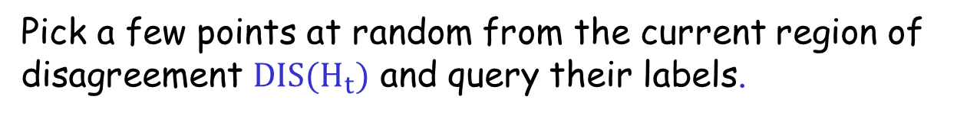


Disagreement Based Active Learning [CAL92]
current version space
region of uncertainy
Algorithm:
Query for the labels of a few random $x_{i}$s.
Let
$H_{1}$ be the current version space.
For $t=1$, ….,
Pick a few points at random from the current region of disagreement $DIS(H_{t})$ and query their labels.
Let $H_{t+1}$ be the new version space.

Slide 23
Region of uncertainty [CAL92]
Current version space: part of C consistent with labels so far.
“Region of uncertainty” = part of data space about which there is still some uncertainty (i.e. disagreement within version space)
current version space
+
+
region of uncertainty in data space

Slide 24
Region of uncertainty [CAL92]
Current version space: part of C consistent with labels so far.
“Region of uncertainty” = part of data space about which there is still some uncertainty (i.e. disagreement within version space)
new version space
+
+
New region of disagreement in data space

Slide 25
How about the agnostic(不可知的) case where the target might not belong the H?
Notes:
Make it specific

Slide 26

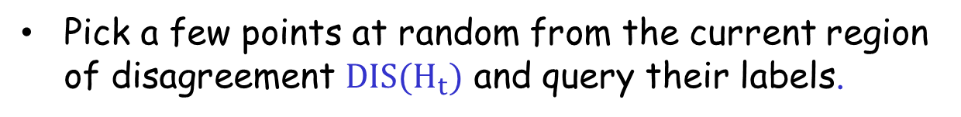

A² Agnostic Active Learner [BBL’06]
current version space
region of disagreement
Algorithm:
Careful use of generalization bounds; Avoid the sampling bias!!!!
Let
$$H_{1}=H.$$
For $t=1$, ….,
Pick a few points at random from the current region of disagreement $DIS(H_{t})$ and query their labels.
Throw out hypothesis if you are statistically confident they are suboptimal.

Slide 27
Other Interesting ALTechniques used in Practice
Interesting open question to analyze under what conditions they are successful.

Slide 28
Density-Based Sampling
Centroid of largest unsampled cluster

Slide 29
Uncertainty Sampling
Closest to decision boundary (Active SVM)

Slide 30
Maximal Diversity Sampling
Maximally distant from labeled x’s

Slide 31
Ensemble-Based Possibilities
Uncertainty + Diversity criteria
Density + uncertainty criteria

Slide 32
What You Should Know
Active learning could be really helpful, could provide exponential improvements in label complexity (both theoretically and practically)!
Common heuristics (e.g., those based on uncertainty sampling). Need to be very careful due to sampling bias.
Safe Disagreement Based Active Learning Schemes.
Understand how they operate precisely in the realizable case (noise free scenarios).

Slide 33
Advanced additional (not required material)
Notes:
Make it specific

Slide 34
Disagreement based algorithms: How about the agnostic case where the target might not belong the H?
Notes:
Make it specific

Slide 35
A² Agnostic Active Learner [BBL’06]
current version space
region of disagreement
Algorithm:
Careful use of generalization bounds; Avoid the sampling bias!!!!
Let
$$H_{1}=H.$$
For $t=1$, ….,
Pick a few points at random from the current region of disagreement $DIS(H_{t})$ and query their labels.
Throw out hypothesis if you are statistically confident they are suboptimal.

Slide 36
Formal General Guarantees for Agnostic AL
A² the first algorithm which is robust to noise.
[Balcan, Beygelzimer, Langford, ICML’06]
[Balcan, Beygelzimer, Langford, JCSS’08]
“Region of disagreement” style: Pick a few points at random from the current region of disagreement, query their labels, throw out hypothesis if you are statistically confident they are suboptimal.
Guarantees for A² [BBL’06,’08]:
It is safe (never worse than passive learning) & exponential improvements.
C – thresholds, low noise, exponential improvement.
c*
C - homogeneous linear separators in R^{d},
D - uniform, low noise, only d² log (1/ε) labels.
A lot of subsequent work.
[Hanneke’07, DHM’07, Wang’09 , Fridman’09, Kolt10, BHW’08, BHLZ’10, H’10, Ailon’12, …]
Notes:
Make it specific

Slide 37
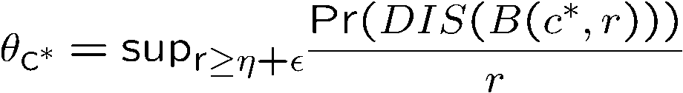
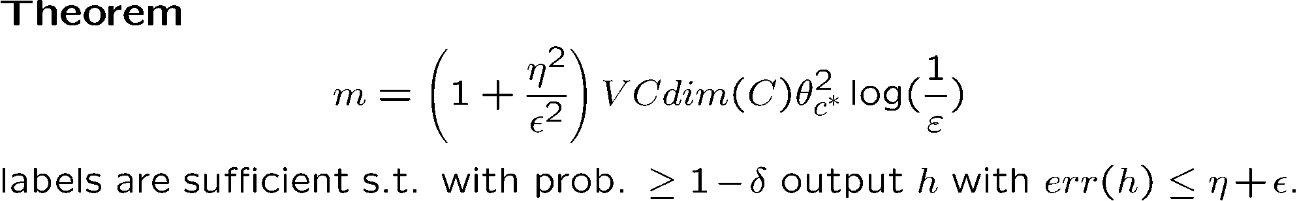
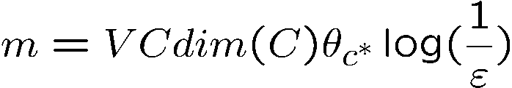

General guarantees for A² Agnostic Active Learner
“Disagreement based”: Pick a few points at random from the current region of uncertainty, query their labels, throw out hypothesis if you are statistically confident they are suboptimal.
[BBL’06]
How quickly the region of disagreement collapses as we get closer and closer to optimal classifier
Guarantees for A² [Hanneke’07]:
Disagreement coefficient
Realizable case:
Linear Separators, uniform distr.:
c*
Notes:
Make it specific

Slide 38
Disagreement Based Active Learning
“Disagreement based ” algos: query points from current region of disagreement, throw out hypotheses when statistically confident they are suboptimal.
Generic (any class), adversarial label noise.
Computationally efficient for classes of small VC-dimension
Still, could be suboptimal in label complex & computationally inefficient in general.
Lots of subsequent work trying to make is more efficient computationally and more aggressive too: [Hanneke07, DasguptaHsuMontleoni’07, Wang’09 , Fridman’09, Koltchinskii10, BHW’08, BeygelzimerHsuLangfordZhang’10, Hsu’10, Ailon’12, …]

Slide 39
applications
Text classification
Web page classification
Junk mail recognition

Slide 40
active learning with different methods
1, Neural Networks
2, Bayesian rule
3, SVM
No matter which method will be used, the core problem will be the same.

Slide 41
active learning with different methods
The core problem is how to select training points actively?
In other words, which training points will be informative to the model?

Slide 42
Apply active learning to Neural Networks
Combined with query by committee
Algorithm:
1, Samples two Neural Networks from distribution
2, when the unlabeled data arrives, use the committee to predict the label
3, if they disagree with each other, select it.

Slide 43
Apply active learning to Neural Networks
Usually:
Committee may contain more than two members.
Classification problem will count #(+) and #(-) to see whether they are close.
Regression problem use the variance of the outputs as the criteria of disagreement.
Stop criteria is maximum model variance dropped below a set threshold.

Slide 44
Apply active learning to Baysian theory
Characteristic:
build a probabilistic classifier which not only make classification decisions, but estimate their uncertainty
Try to estimate P(Ci | w), posterior probability that an example with pattern w belongs to class Ci.
P(Ci | w) will directly guide to select training data.

Slide 45
Apply active learning to SVM
Problem is also what is the criteria for uncertainty sampling?
we can improve the model by attempting to maximally narrow the existing margin.
If the points which lie on or close to the dividing hyperplane are added into training points, it will on average narrow the margin most.

Slide 46
Apply active learning to Baysian theory
About the stopping criteria:
All unlabeled data in the margin have been exhausted, we will stop.
Why?
Only unlabeled data within the margin will have great effect on our learner.
Labeling an example in the margin may shift the margin such that examples that were previously outside are now inside.

Slide 47
Employing EM and Pool-based Active Learning for Text Classification
Motivation:
Obtaining labeled training examples for text classification is often expensive, while gathering large quantities of unlabeled examples is very cheap.
Here, we will present techniques for using a large pool of unlabeled documents to improve text classification when labeled training data is sparse.

Slide 48
How data are produced
We approach the task of text classification from a bayesian learning perspective, we assume that the documents are generated by a particular parametric model, mixture of naïve nayes, and one-to-one correspondence between class labels and the mixture components.

Slide 49

How data are produced
The likelihood of a document is a sum of total probability over all
generative components
,Indicate the jth component and jth class
Each component cj is parameterized by a disjoint subset of θ

Slide 50


How data are produced
Document di is considered to be an ordered list of word events.
Wdik represents the word in position k of document di. The subscript of w indicates an index into the vocabulary V=<w1,w2,…,w|v|>.
Combined with standard naïve bayes assumption: words are independent from other words in the same document.

Slide 51
goal
Given these underlying assumption of how data are produced, the task of learning a text classifier consists of forming an estimate of θ, written as based on a training set.

Slide 52

Formular
If the task is to classify a test document di into a single class, simply select the class with the highest posterior probability: argmaxj P(cj|dj; )

Slide 53
EM and Unlabeled data
problem:
When naïve bayes is given just a small set of labeled training data, classifiction accuracy will suffer because variance in the parameter estimates of the generative model will be high.

Slide 54
EM and Unlabeled data
Motivation:
By augmenting this small labeled set with a large set of unlabeled data and combining the two pools with EM, we can improve the parameter estimates.

Slide 55
implementation of EM
Initialize just using labeled data.
E-step:
Calculate probabilistically-weighted class labels, P(cj | dj; ), for every unlabeled document.
M-step:
Calculate a new maximum likelihood estimate for θ using all the labeled data.
The process iterate until reaches a fixed point

Slide 56
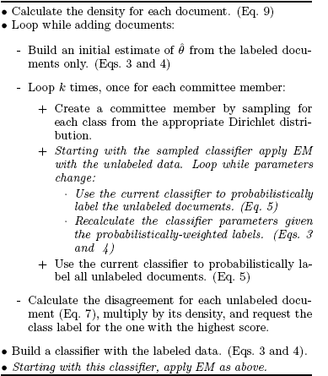
Active learning with EM

Slide 57
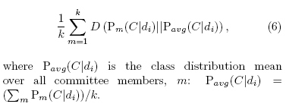
Disagreement creteria
To measure committee disagreement for each document using Kullback-Leibler divergence to the mean.
KL divergence to the mean is an average of the KL divergence between each distribution and the mean of all the distributions:

Slide 58
END
Thank you

